Slide 1
Recognizing Hand Gestures
Anagha Fatale
Namrata Arkalgud

Slide 2
Introduction
Along with speech, hand gestures are also considered as a natural form of human communication
Many times, human gestures form a way of communication where language is a barrier
Gestures can be used to communicate easily with people having disabilities

Slide 3
Flow of Code
1.Data segregation into test, train
2.Extraction of images from Videos
3.Data Cleaning (encode one hot, rescaling)
4.Extraction of features from images
5.Training the model
6.Predicting
Flow Structure

Slide 4
Data Set
We have implemented neural network for hand gestures recognition for data from UCF data set
Videos like writing, typing
13,320 videos from 101 action categories
Diverse in terms of actions.
Variations in camera motion
Object appearance and pose
Cluttered background

Slide 5
Data Preparation
Split all the videos into train/test folders
Extract jpegs of each frame for each video using “ ffmpeg” with a frame rate of 40 frames per second
Summarize the videos, their class, train/test status and frame count in a CSV we will reference throughout our training

Slide 6
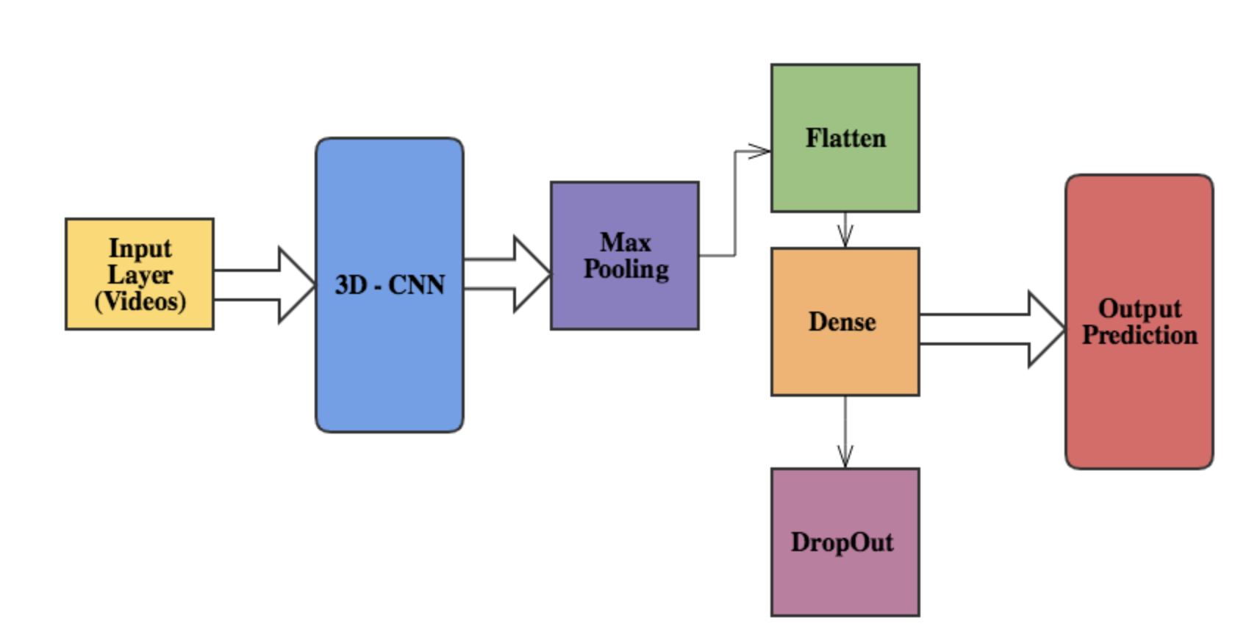
Architecture

Slide 7
Important Libraries Used
keras.preprocessing (Image Generator)
keras.applications.inception_v3
keras.models
keras.layers
keras.optimizers
keras.layers.wrappers
keras.layers.convolutional (MaxPooling3D, Conv3D)
Libraries

Slide 8
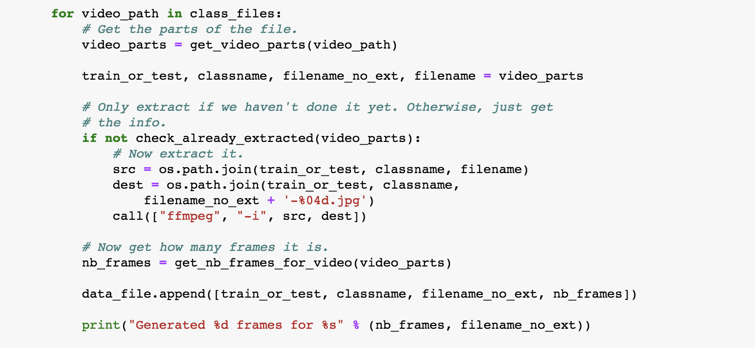
Image Extraction from Videos
Pseudo Code
Extracting frames from videos

Slide 9
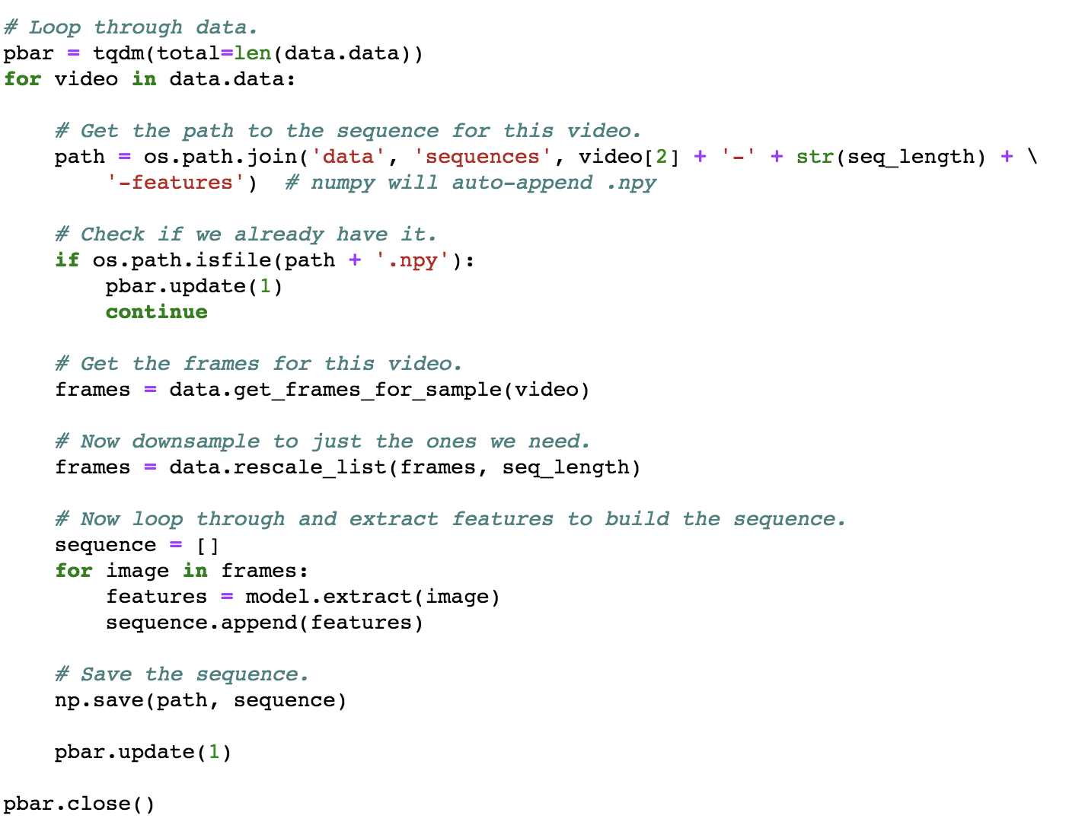
Extracting features for videos
Pseudo Code

Slide 10
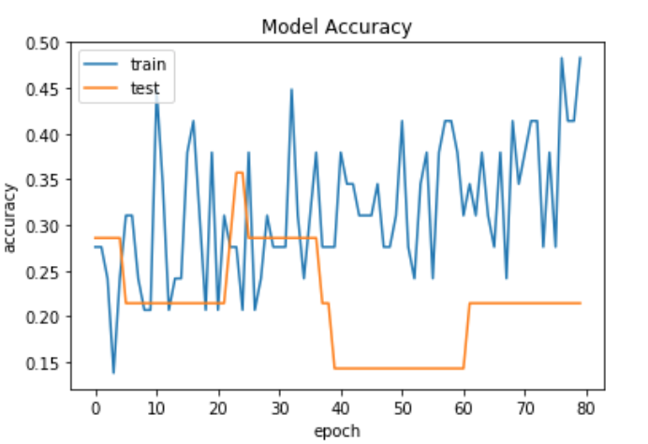
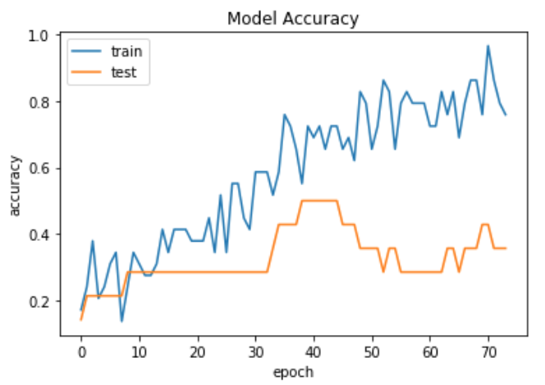
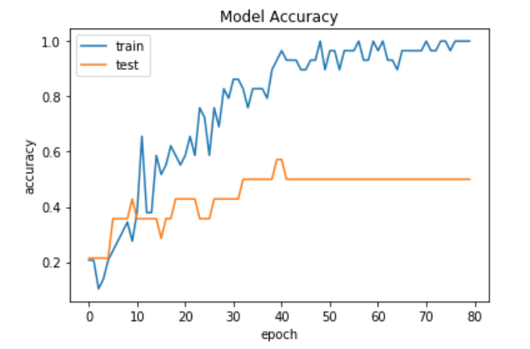
Model Comparison
CNN-LSTM
3D CNN
LSTM

Slide 11
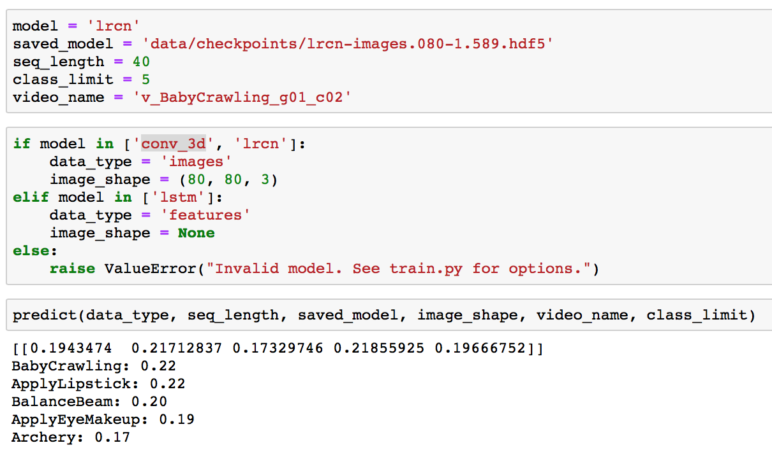
Prediction CNN-LSTM

Slide 12

Prediction LSTM

Slide 13
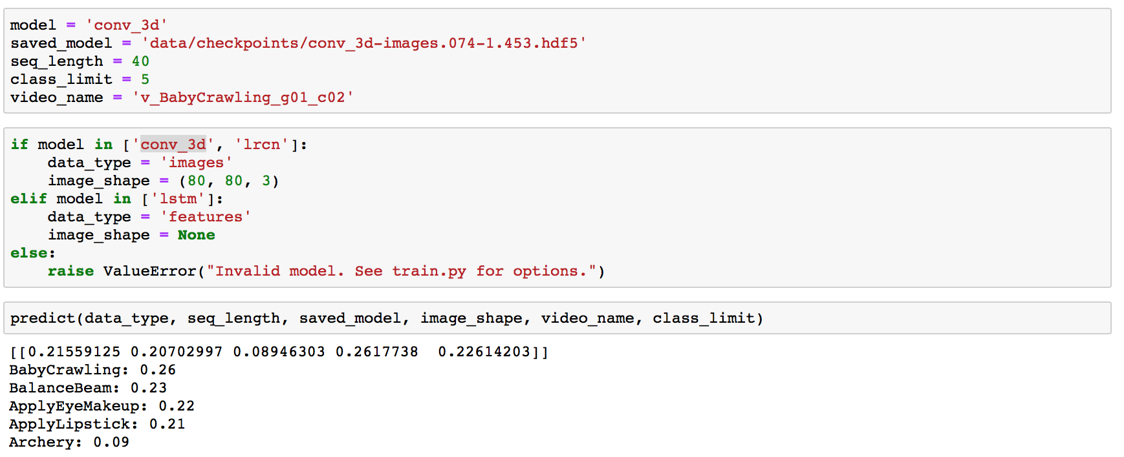
Prediction 3D CNN

Slide 14
Future Work
Would like to work on unsupervised model
Predict with live hand gestures in real time
Work with a streaming data set

Slide 15
Thank you!!

